Slide 1
Probability Review

Slide 2
Why Probabilistic Robotics?
autonomous mobile robots need to accommodate the uncertainty that exists in the physical world
sources of uncertainty
environment
sensors
actuation
software
algorithmic
probabilistic robotics attempts to represent uncertainty using the calculus of probability theory

Slide 3
Axioms of Probability Theory
Pr(A) denotes probability that proposition A is true.

Slide 4
A Closer Look at Axiom 3

Slide 5
Using the Axioms

Slide 6
Discrete Random Variables
X denotes a random variable.
X can take on a countable number of values in {x₁, x₂, …, x_{n}}.
P(X=x_{i} ), or P(x_{i} ), is the probability that the random variable X takes on value x_{i}.
P( ∙ ) is called probability mass function.

Slide 7
Discrete Random Variables
fair coin
fair dice
P(X=heads) = P(X=tails) = 1/2
P(X=1) = P(X=2) = P(X=3) = P(X=4) = P(X=5) = P(X=6) = 1/6

Slide 8
Discrete Random Variables
sum of two fair dice
P(X=2) | (1,1) | 1/36
P(X=3) | (1,2), (2,3) | 2/36
P(X=4) | (1,3), (2,2), (3,1) | 3/36
P(X=5) | (1,4), (2,3), (3,2), (4,1) | 4/36
P(X=6) | (1,5), (2,4), (3,3), (4,2), (5,1) | 5/36
P(X=7) | (1,6), (2,5), (3,4), (4,3), (5,2), (6, 1) | 6/36
P(X=8) | (2, 6), (3, 5), (4,4), (5,3), (6, 2) | 5/36
P(X=9) | (3, 6), (4, 5), (5, 4), (6, 3) | 4/36
P(X=10) | (4, 6), (5, 5), (6, 4) | 3/36
P(X=11) | (5, 6), (6, 5) | 2/36
P(X=12) | (6, 6) | 1/36

Slide 9
Discrete Random Variables
plotting the frequency of each possible value yields the histgram
6
5
4
frequency
3
2
1
2
3
4
5
6
7
8
9
10
11
12

Slide 10
Continuous Random Variables
X takes on values in the continuum.
p(X=x), or p(x), is a probability density function.
E.g.
p(x)
x

Slide 11
Continuous Random Variables
unlike probabilities and probability mass functions, a probability density function can take on values greater than 1
the textbook authors warn you (on p15) that they use the terms probability, probability density, and probability density function interchangeably

Slide 12
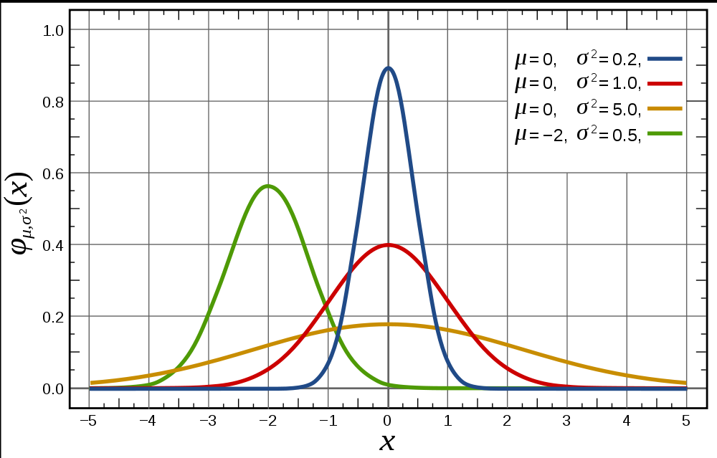
Continuous Random Variables
normal or Gaussian distribution in 1D

Slide 13
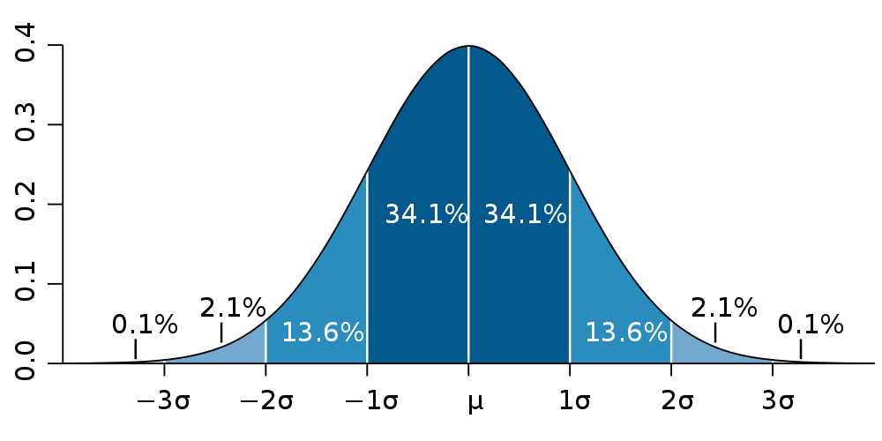
Continuous Random Variables
1D normal, or Gaussian, distribution
mean
standard deviation
variance

Slide 14
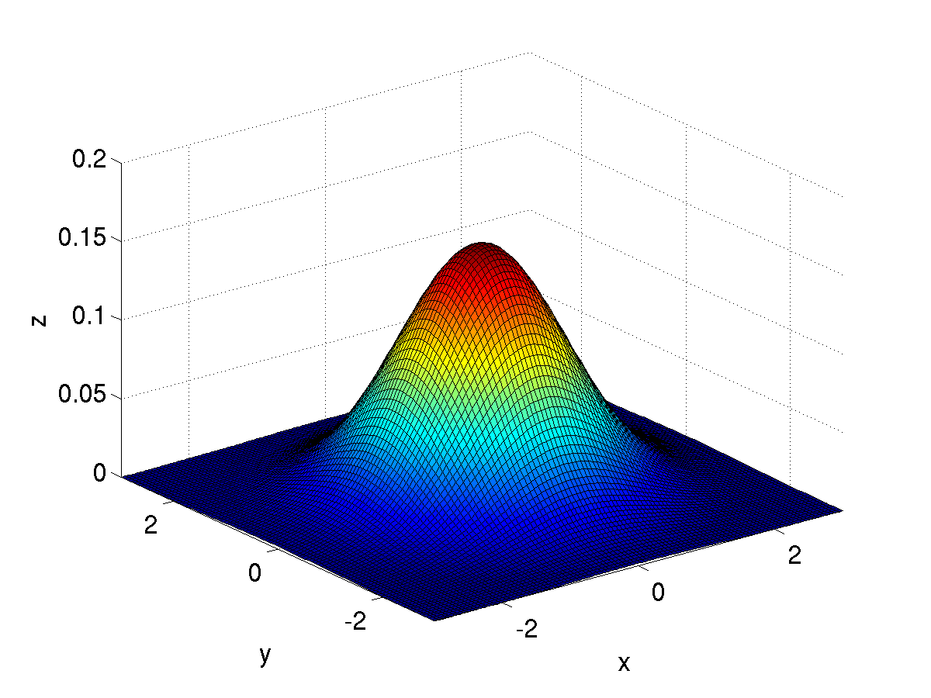
Continuous Random Variables
2D normal, or Gaussian, distribution
mean
covariance matrix

Slide 15
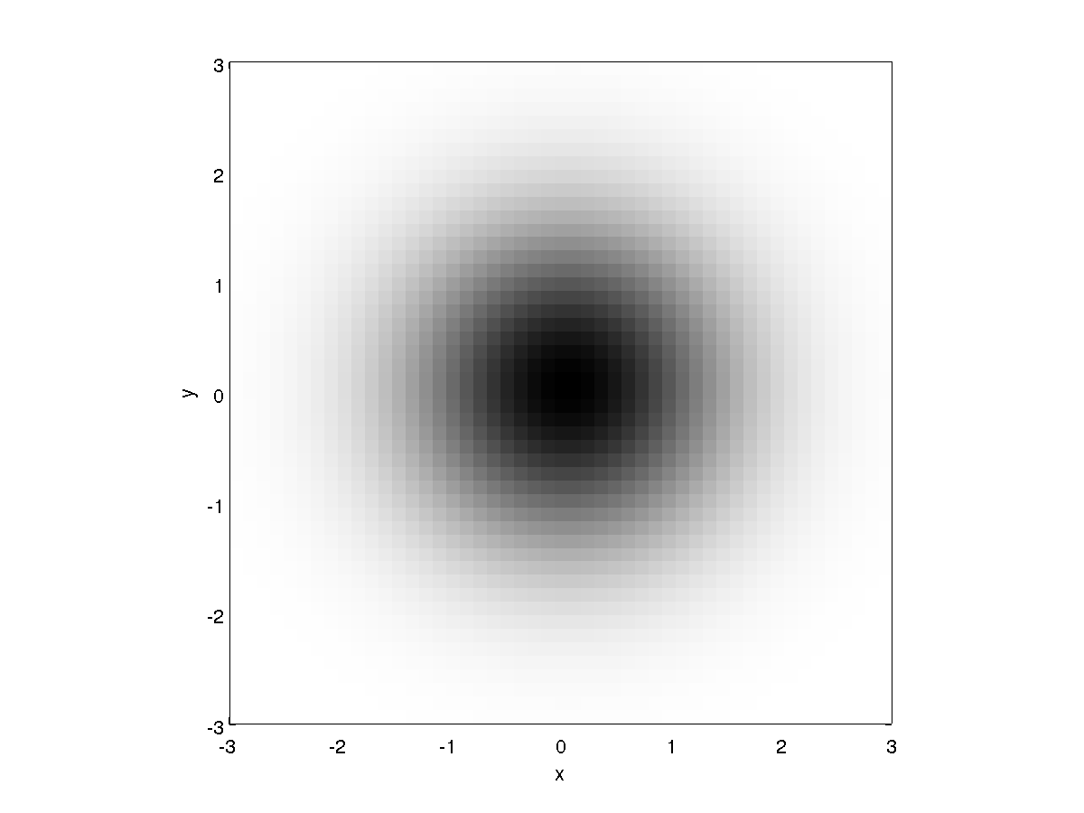
Continuous Random Variables
in 2D
isotropic

Slide 16
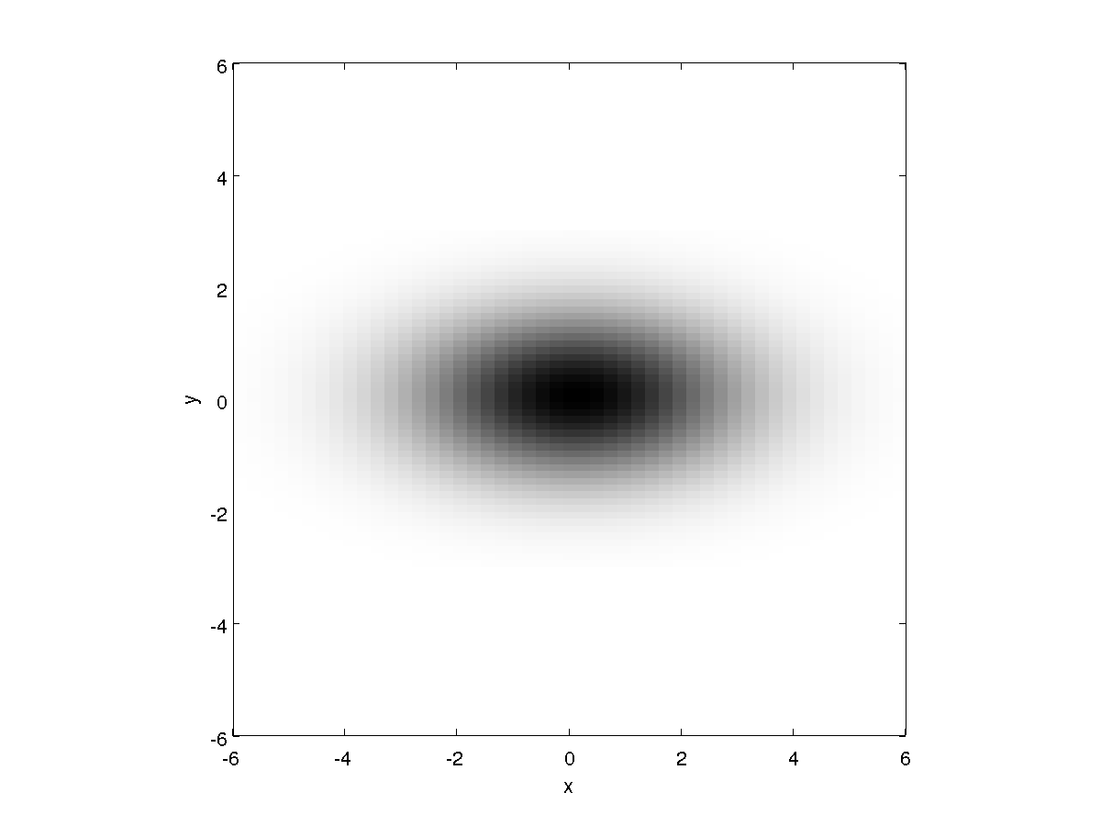
Continuous Random Variables
in 2D
anisotropic

Slide 17
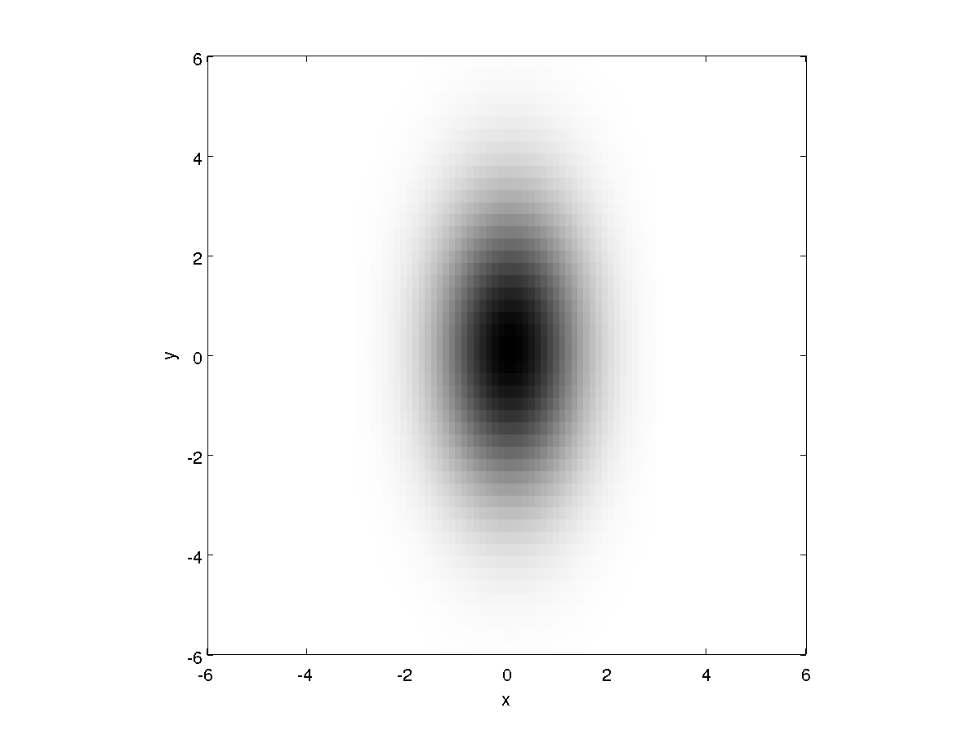
Continuous Random Variables
in 2D
anisotropic

Slide 18
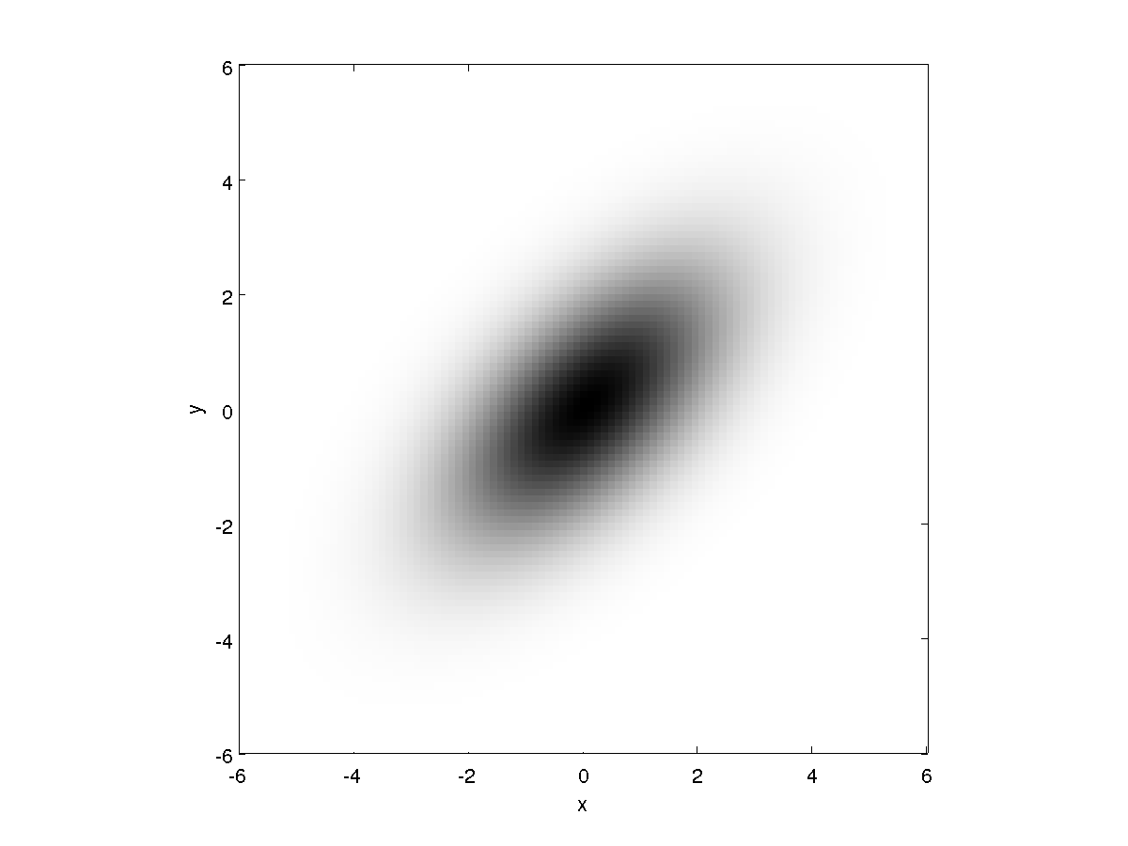
Continuous Random Variables
in 2D
anisotropic

Slide 19
Joint Probability
the joint probability distribution of two random variables
P(X=x and Y=y) = P(x,y)
describes the probability of the event that X has the value x and Y has the value y
If X and Y are independent then P(x,y) = P(x) P(y)

Slide 20
Joint Probability
the joint probability distribution of two random variables
P(X=x and Y=y) = P(x,y)
describes the probability of the event that X has the value x and Y has the value y
example: two fair dice P(X=even and Y=even) = 9/36 P(X=1 and Y=not 1) = 5/36

Slide 21
Joint Probability
example: insurance policy deductibles
y
 | $0 | $100 | $200
$100 | 0.20 | 0.10 | 0.20
$250 | 0.05 | 0.15 | 0.30
home
x
automobile

Slide 22
Joint Probability and Independence
X and Y are said to be independent if
P(x,y) = P(x) P(y)
for all possible values of x and y
example: two fair dice P(X=even and Y=even) = (1/2) (1/2) P(X=1 and Y=not 1) = (1/6) (5/6)
are X and Y independent in the insurance deductible example?

Slide 23
Marginal Probabilities
the marginal probability distribution of X describes the probability of the event that X has the value x
similarly, the marginal probability distribution of Y describes the probability of the event that Y has the value y

Slide 24
Joint Probability
example: insurance policy deductibles
y
 | $0 | $100 | $200
$100 | 0.20 | 0.10 | 0.20
$250 | 0.05 | 0.15 | 0.30
home
x
automobile

